Slide 1
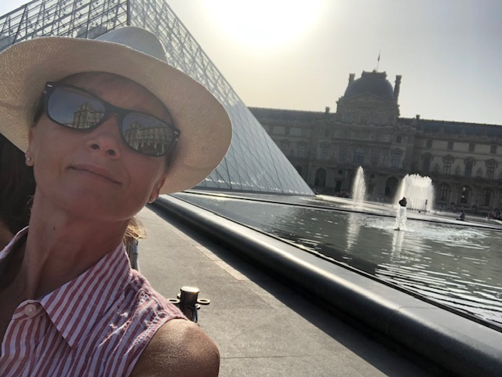
Bonsoir!!! Bienvenue au cours de français de M-me Seminara

Slide 2
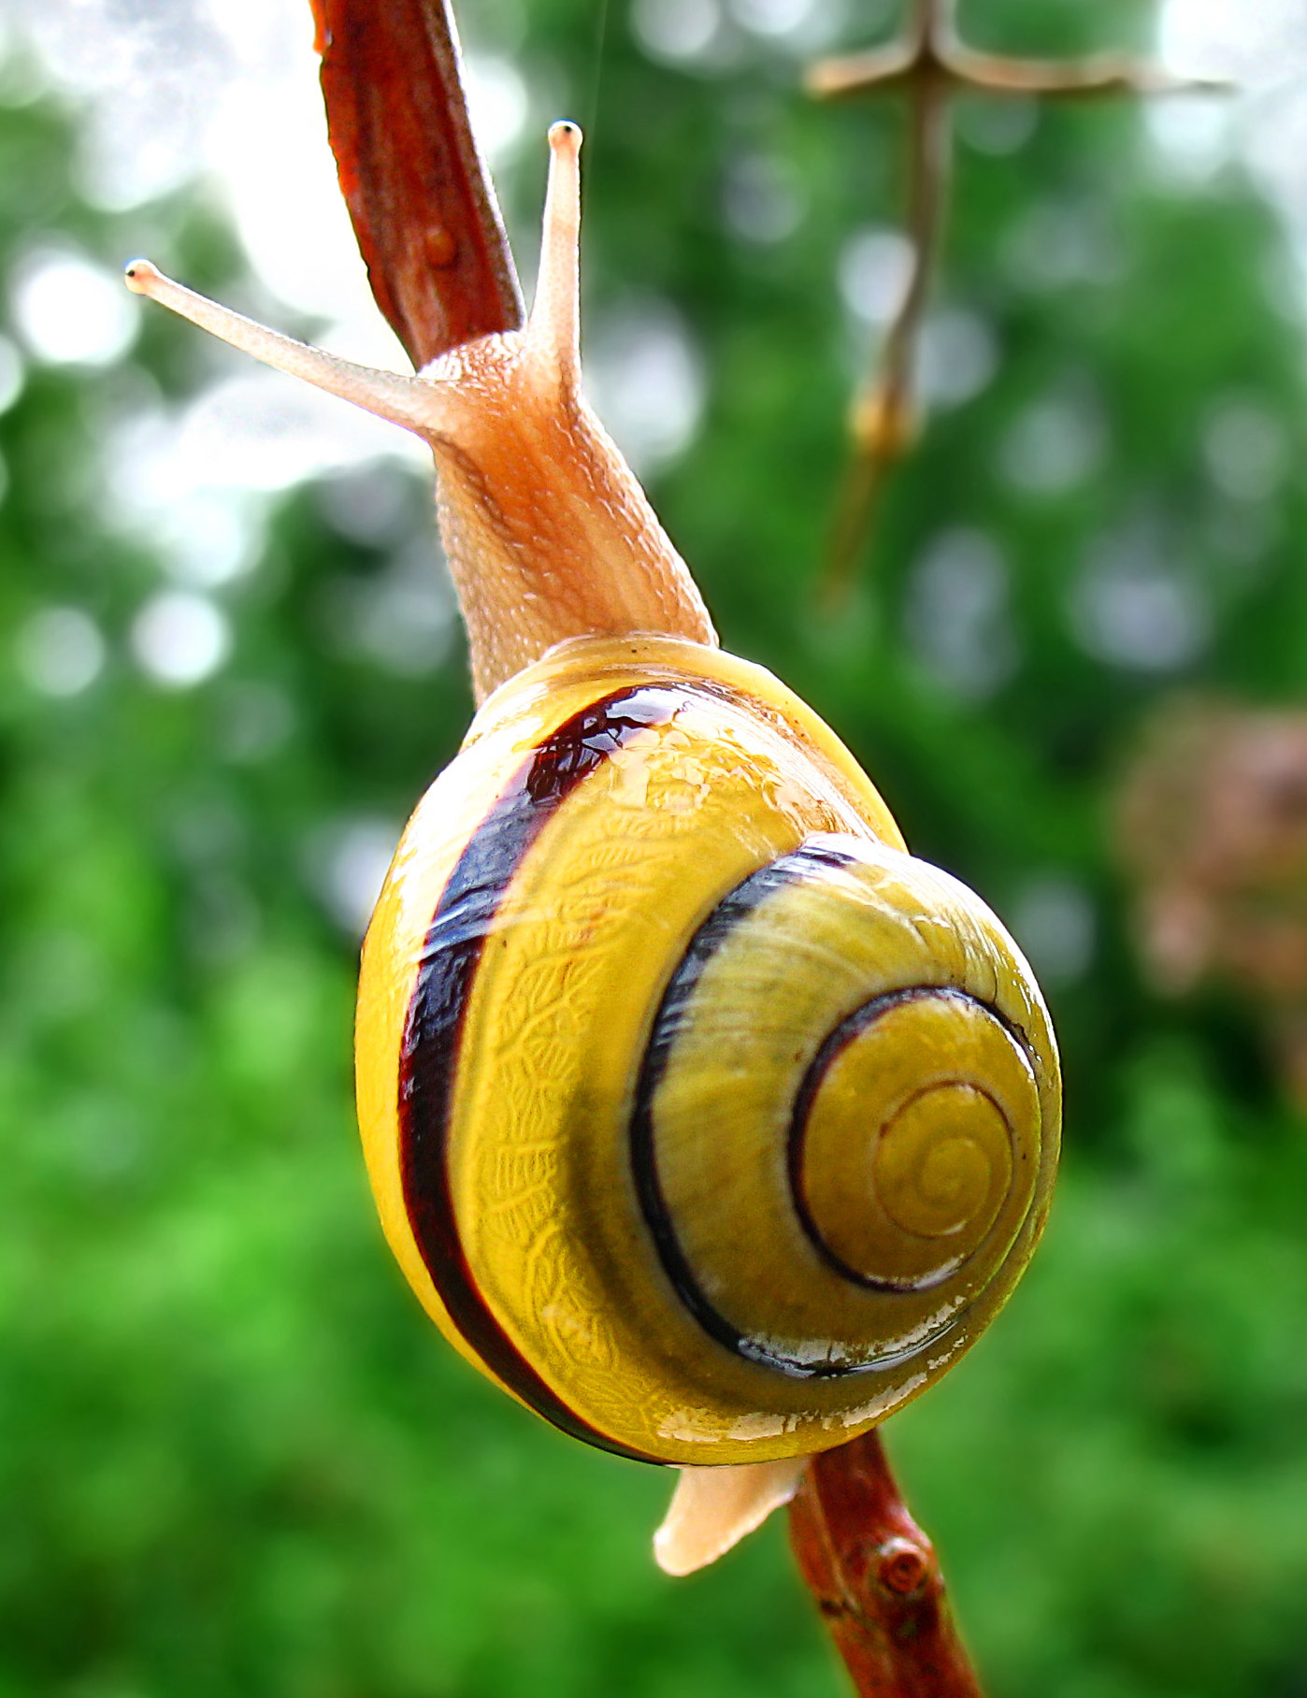
Class Philosophy:
Come out of your shell!
Students should feel safe to experiment in the second language and express themselves in French from day 1, they know that it is OK to make mistakes

Slide 3
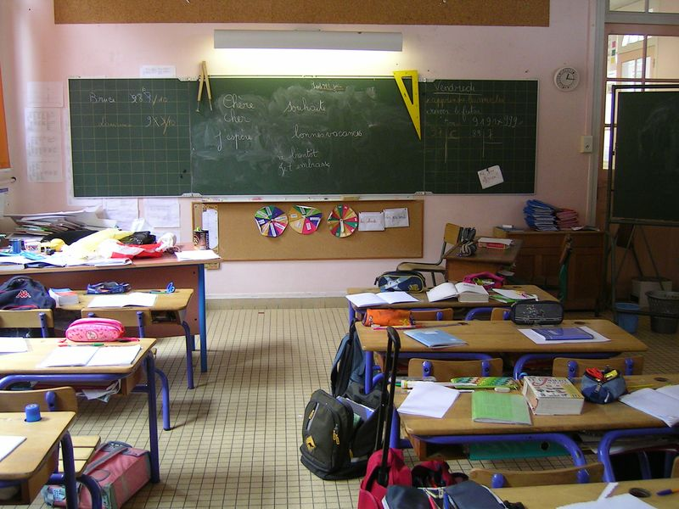
Thematic Units Covered: French grade 7
Unit 1: I am unique
Unit 2: Family
Unit 3: School Life
Unit 4: Endangered species
Unit 5: The Great Outdoors

Slide 4
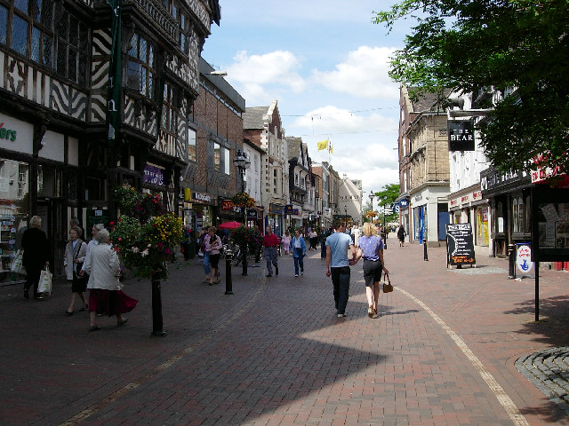
Thematic Units Covered: French grade 8
Unit 1: All about me
Unit 2: Food, glorious food
Unit 3: Let’s go shopping!
Unit 4: Home, sweet home
Unit 5: City life
Unit 6: My dream vacation

Slide 5
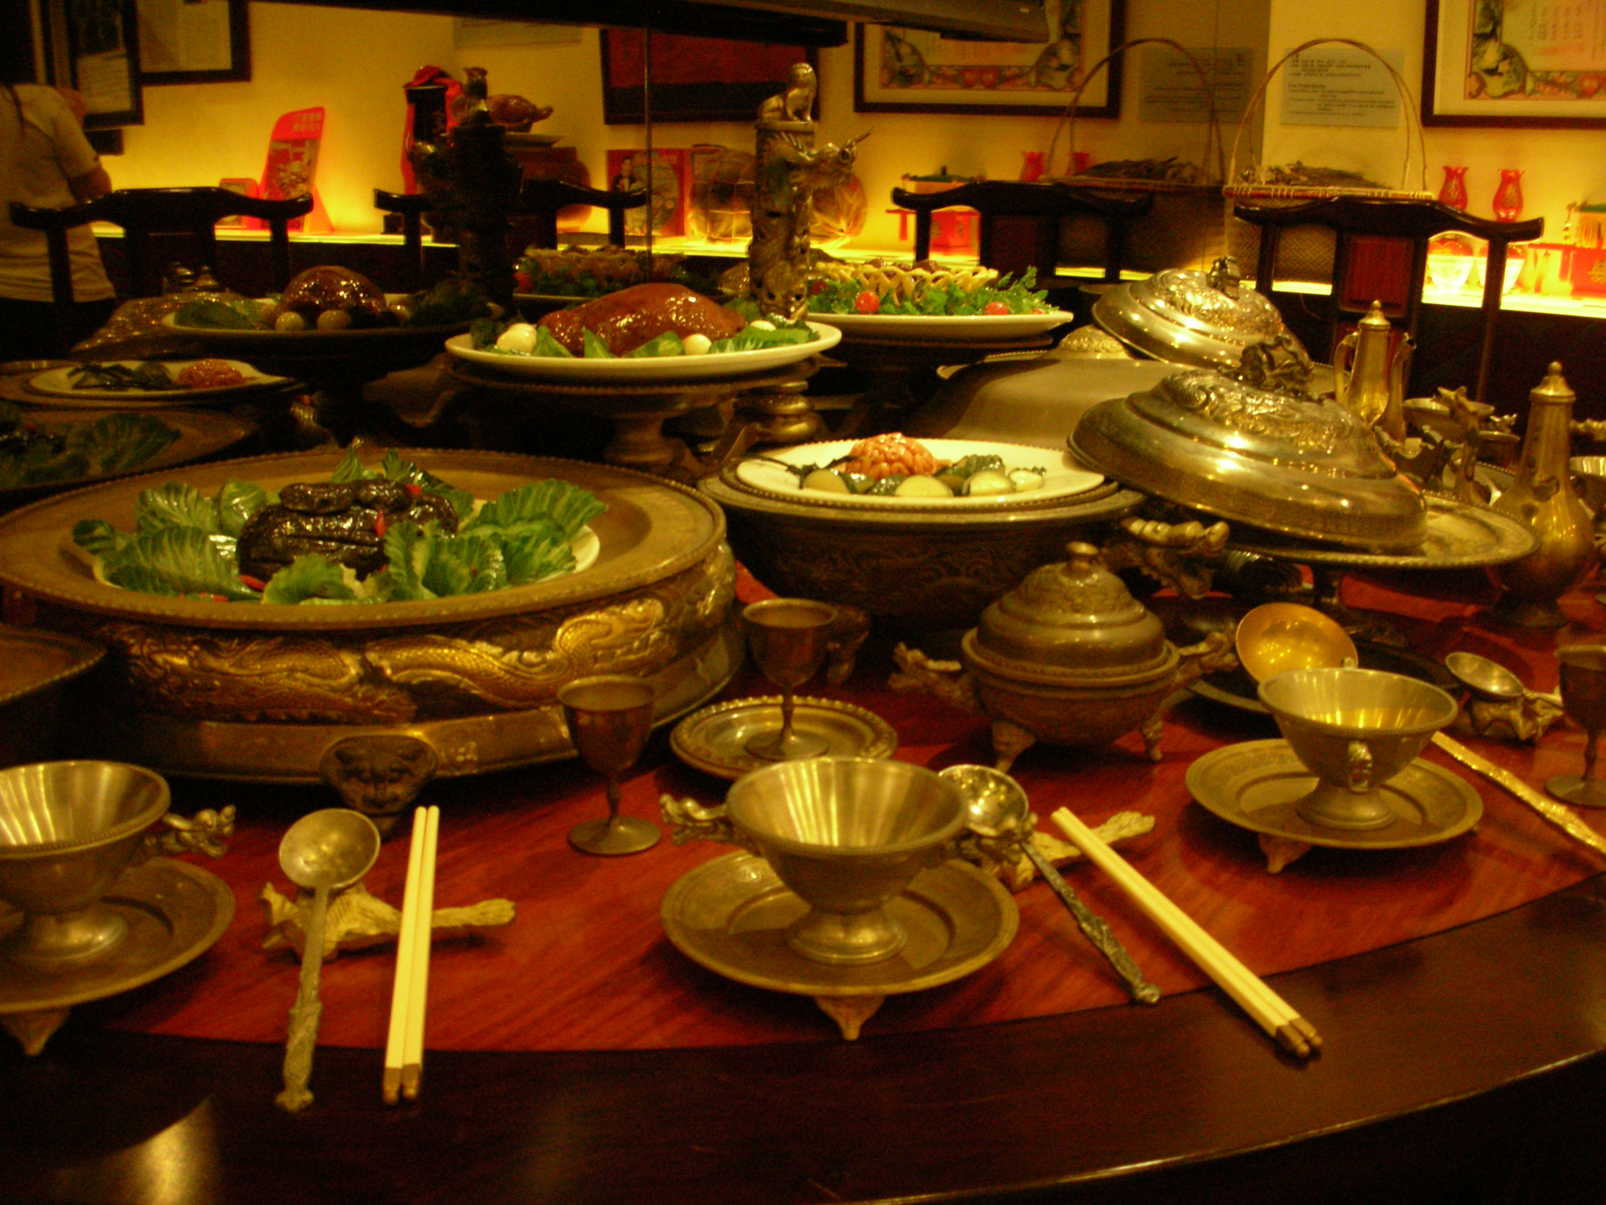
Thematic Units Covered: French 2
Unit 1: Family and Community
Sub-unit 1: My Family and Friends
Sub-unit 2: Cultural Celebrations
Sub-unit 3: Food Shopping
Unit 2: Contemporary Life
Sub-unit 1: In the High School
Sub-unit 2: A Typical Day of a Teen
Mini-unit: A Time Capsule ( an inter-cultural project with a sister school in France)

Slide 6
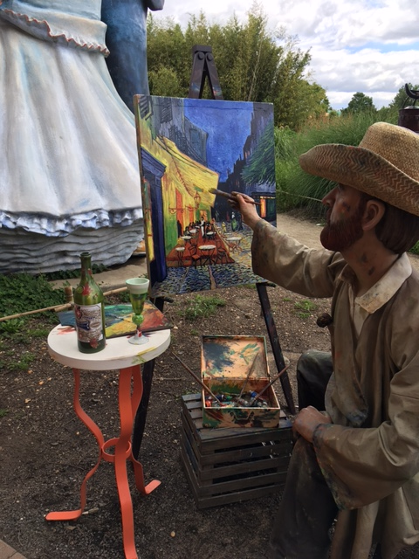
Thematic Units Covered
French 3:
Unit 1: The Good Old Times
Unit 2: Country life vs City life
Unit 3: My Future
Unit 4: Being in a Good Shape
Unit 5: Our planet
Unit 6: Entertainment

Slide 7
French 4Honors Curriculum
Emphasis on intercultural perspectives, products and practices

Slide 8
Unit 1: Les Moments de la vie – Life’s Important Moments
Unit 2: La Francophonie - Cultural Heritage of the French-Speaking World
Unit 3. La France d’hier et d’aujourd’hui – France yesterday and today
Unit 4: Les Defies Mondiaux– Global Challenges
Every Monday – Independent reading assignments are due

Slide 9
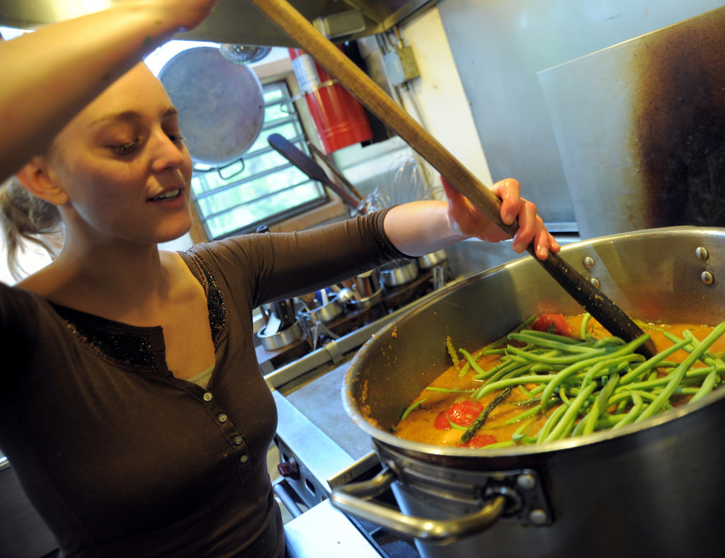
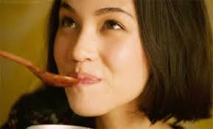
ASSESSMENT
40% - formative assessment to measure the learning progress, give feedback and adjust instruction
50 % - summative to evaluate acquired skills
10%- participation
(rubric)

Slide 10
FORMATIVE ASSESSMENT 40%
Weekly Work : classwork completion, quick chat, essential questions, quizzes
Independent listening and reading (French 4h/5AP only)

Slide 11
SUMMATIVE ASSESSMENT 50%
quests, culture quizzes, tests, performance-based assessment (ROLE PLAY, INTERVIEWS, PROJECTS, STORY WRITING) Creativity Counts!!!

Slide 12
ASSESSMENT
10% - participation: self-reflection

Slide 13
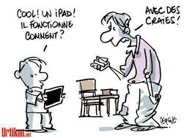
Technology:
Students need headphones!
We use google classroom daily, online voice recorder, Flipgrid

Slide 14
We will still use paper, so reserve a section of your binder to French handouts and have some loose paper

Slide 15
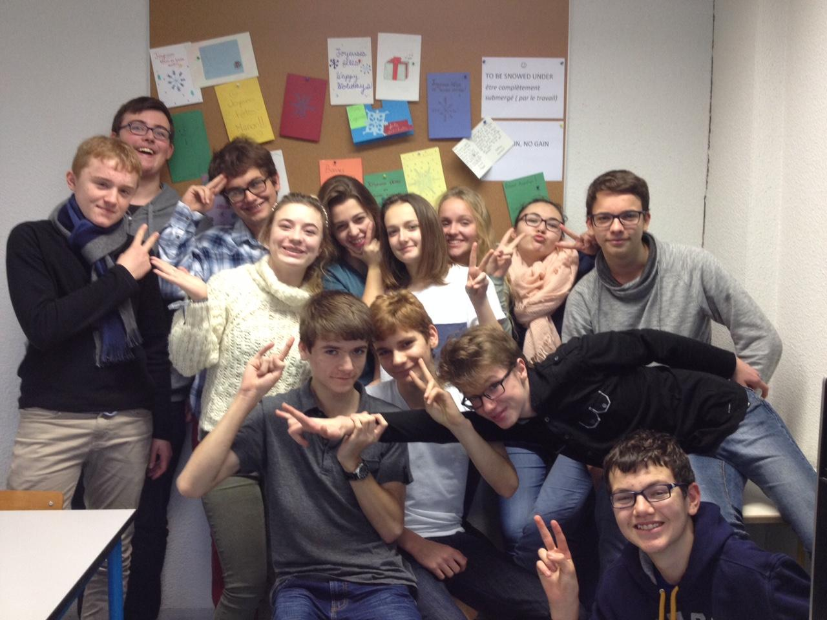
E-pals exchange: Lycée Charleville Mézières, Ardennes

Slide 16
FRENCH CLUB
Everyone welcome
Meeting on alternating days weekly for 20 minutes (Fall/Spring) and bi-weekly for 40 minutes in the winter
Sign -in required
Activities: e-pals, games, cooking classes, conversation, cultural presentations, bake sales, restaurant trip, National French Week, peer tutoring

Slide 17
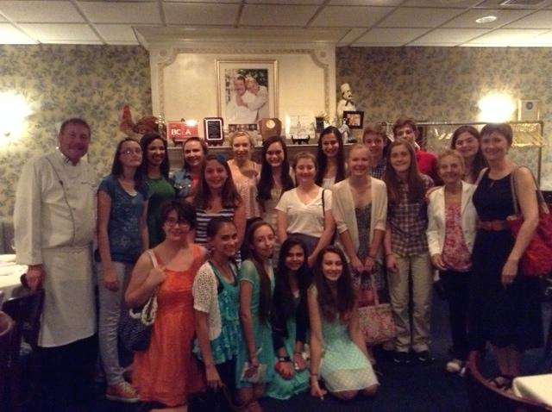
Madeleine’s Petit Paris trip

Slide 18
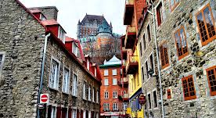
Québec Trip 2024
Midland Park High School French Trip to Québec TBA

